Slide 1
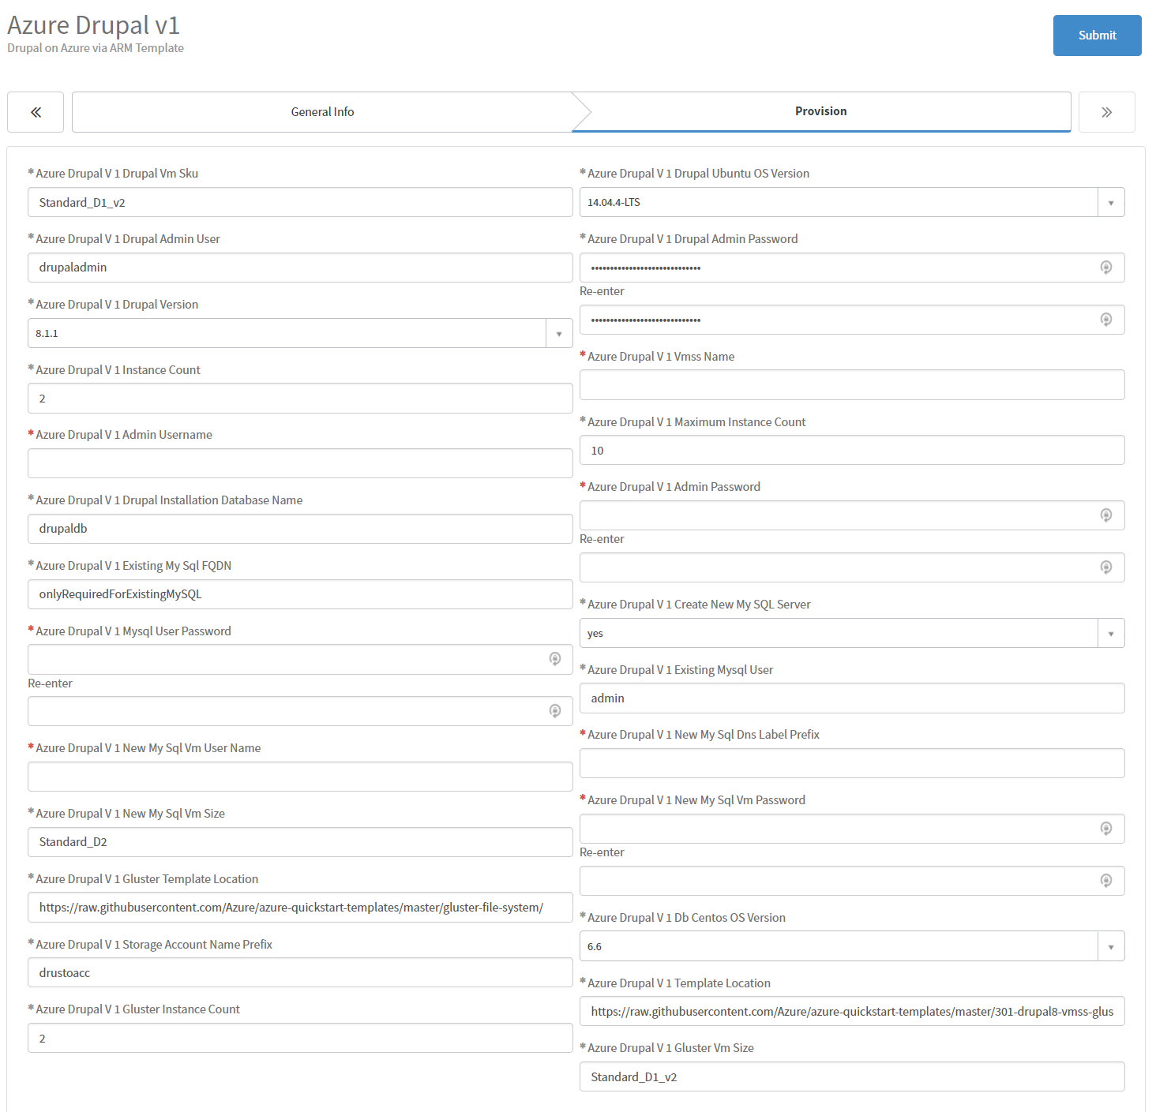
Suggest 8-character username (not “admin”)
Typically use a copy of the “Stack Name” here from “General Info” tab
16-character alphanumeric string. Cannot match “Admin Password” or “SQL VM Password.”
16-character alphanumeric string. Cannot match “MySQL User Password” or “MySQL VM Password.”
Suggest 8-character username (not “admin”)
Cannot match “vmss name” above
16-character alphanumeric string. Cannot match “Admin Password” or “MySQL User Password.”

